Slide 1
COMP 4290
Week 10 - Monday

Slide 2
Last time
Network reconnaissance
Eavesdropping
Wireless vulnerabilities
Started denial of service attacks

Slide 3
Questions?

Slide 4
Project 3

Slide 5
Colm Oneacre Presents

Slide 6
Denial of Service

Slide 7
Denial of service
Networks are one of the best places to launch an attack on availability
In this setting, these are usually called denial of service (DoS) attacks
DoS attacks are very hard to avoid

Slide 8
Ways to make DoS happen
Flooding overloads capacity
Ask for too many connections
Request too many of some other service
Blocking access
Crash an application
Interfere with network routing protocols
Access failure
Hardware or software fails

Slide 9
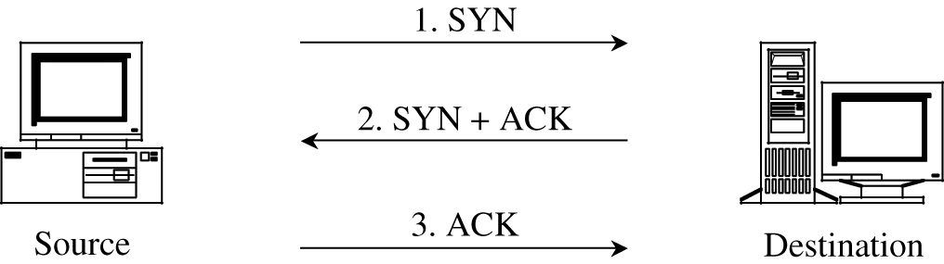
SYN flood
TCP is built on a three-way handshake
Client requests a connection by sending a SYN packet
The server acknowledges the request by sending a SYN-ACK packet back
The client responds with an ACK, establishing the connection
An attacker can just keep sending SYN packets
The server will allocate some resources, wait for the ACK, and never get it
A clever attacker will spoof at least his own IP so that the SYN-ACK is sent elsewhere
A more sophisticated attacker will spoof many different IP addresses (or have many bots in a botnet) sending all these SYN's

Slide 10
Other denial of service attacks
Echo-chargen
Chargen sets up a stream of packets for testing
Echo packets are supposed to be sent back to the sender
If you can trick a server into sending echo packets to itself, it will respond to its own packets forever
Ping of death
A ping packet requests a reply
If you can send more pings than a server can handle, it goes down
Only works if the attacker has more bandwidth than the victim (DDoS helps)
Smurf
A ping packet is broadcast to everyone, with the victim spoofed as the originator
All the hosts try to ping the victim
The real attacker is hidden
Teardrop
A teardrop attack uses badly formed IP datagrams
They claim to correspond to overlapping sequences of bytes in a packet
There's no way to put them back together and the system can crash

Slide 11
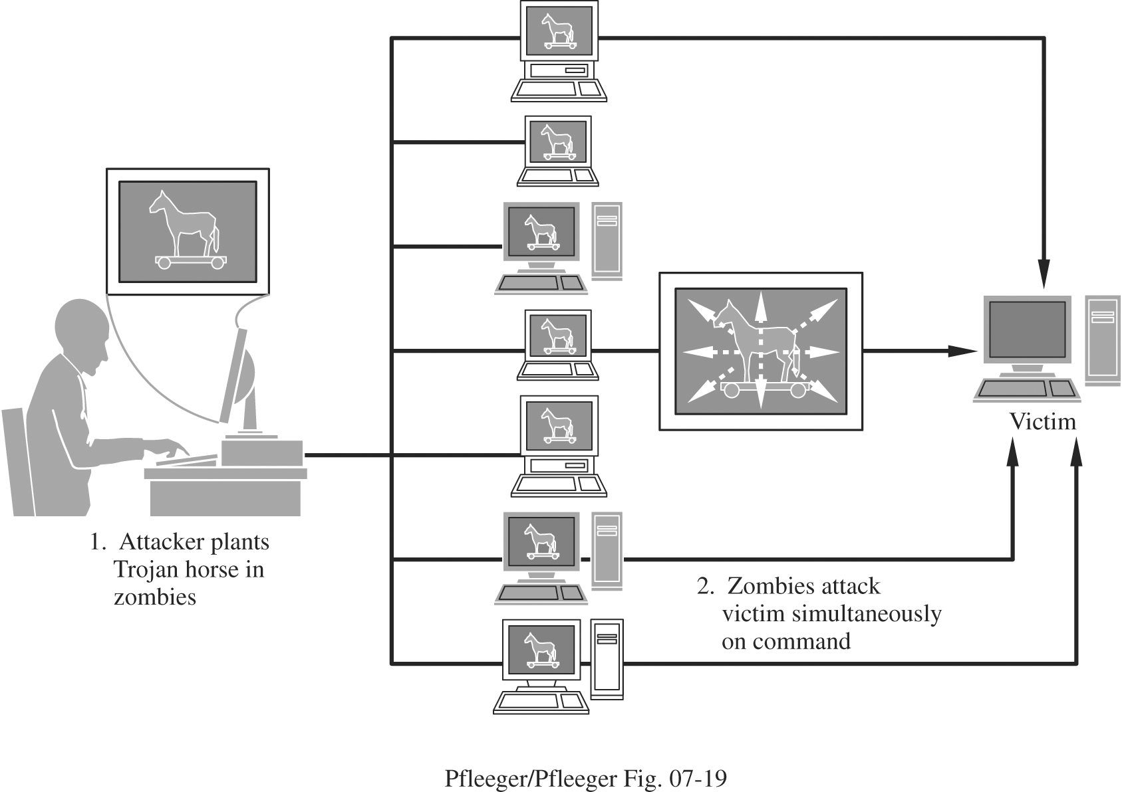
Distributed denial of service
Distributed denial of service (DDoS) attacks use many machines to perform a DoS attack
Usually, many targets have been compromised with a Trojan horse making them zombies or bots
These zombie machines are controlled by the attacker, performing flooding or other attacks on a victim
A network of zombies is called a botnet
The attacker is hard to trace

Slide 12
Stopping DDoS attacks
The best defense is prevention
DDoS attacks are usually mounted by bots that were compromised by known vulnerabilities
Patch your stuff!
Defense against DoS attacks:
Tuning: adjusting the number of active servers
Load balancing: redirecting traffic to servers that aren't getting used
Shunning: reducing service given to certain IP addresses
Blacklisting: ignoring traffic from known bad IP addresses

Slide 13
DNS attacks
The Domain Name System (DNS) uses Domain Name Servers (also DNS) to convert user readable URLs like google.com to IP addresses
Taking control of a server means that you get to say where google.com is
Called DNS spoofing
For efficiency, servers cache results from other servers if they didn't know the IP
DNS cache poisoning is when an attacker gives a good server a bad IP address

Slide 14
Summary of vulnerabilities
Target | Vulnerability | Target | Vulnerability
Precursors to attack | Port scan Social engineering Reconnaissance OS and application fingerprinting | Confidentiality | Protocol flaw Eavesdropping Passive wiretap Misdelivery Exposure Traffic flow analysis
Authentication failures | Impersonation Guessing Eavesdropping Spoofing Session hijacking Man in the middle attack | Integrity | Protocol flaw Active wiretap Impersonation Falsification Noise Web site defacement DNS attack
Programming flaws | Buffer overflow Addressing errors Server-side include Malicious Java or ActiveX Worms, viruses, Trojan horses | Availability | Protocol flaw Transmission failure Flooding DNS attack Traffic redirection DDoS

Slide 15
Network Security Controls

Slide 16
Architecture
Good network architecture can make security better
Segmentation means separating the network into different parts
Web server
Database server
Application servers
Redundancy is important
Multiple servers that check if each other have gone down
Avoid single points of failure

Slide 17
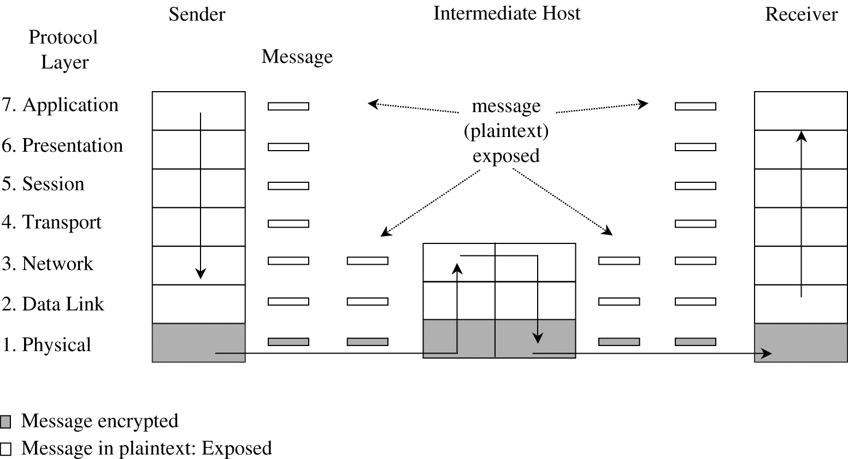
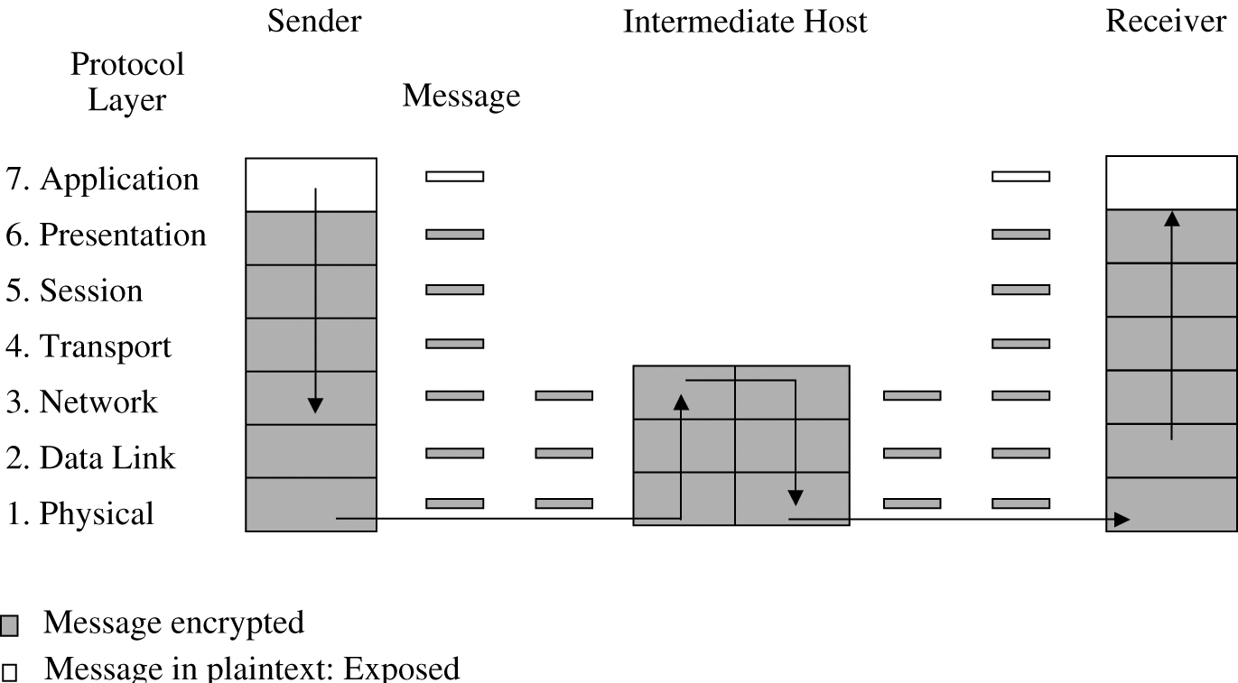
Encryption
Encryption is important for network security
Link encryption encrypts data just before going through the physical communication layer
Each link between two hosts could have different encryption
Message are in plaintext within each host
Link encryption is fast and transparent
End-to-end encryption provides security from one end of the transmission to the other
Slower
Responsibility of the user
Better security for the message in transit

Slide 18
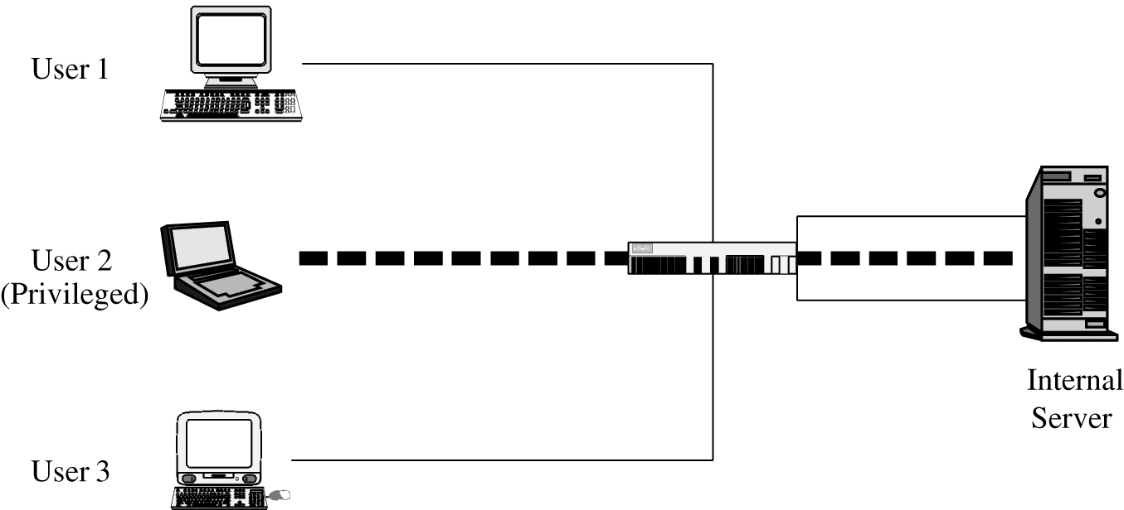
Virtual private networks
Encryption that allows people in a public network to communicate securely with a private network creates a virtual private network (VPN)
A user's system negotiates a key with a firewall that guards a private network
Communication takes place in a tunnel

Slide 19
Public key infrastructure
As we discussed before, the big problem with public keys is making sure you get the right one
Public key infrastructure (PKI) is the solution to this problem
A PKI sets up certificate authorities who certify that keys belong to who they're supposed to
Their jobs include:
Managing public key certificates
Issuing certificates that connect a user to a key
Scheduling certificate expiration
Publishing certificate revocation lists

Slide 20
Secure protocols
SSH (secure shell) is a protocol for encrypted communication between computers
Designed for Unix/Linux, but available on Windows
Telnet, rlogin, and rsh should be replaced by SSH
Negotiates symmetric key encryption usually using public key encryption, similar to Project 2
TLS (transport layer security) creates a secure session (golden lock) between a web browser and a web server

Slide 21
Onion routing
With link and end-to-end encryption, the data is encrypted, but the addresses are not
Onion routing uses forwarding hosts where only the first host knows where the data came from and only the last host knows where the data is going
It uses public key cryptography to work
It's inefficient, but traffic analysis is nearly impossible
Tor is a system developed to do onion routing
Such systems allow bad guys to keep their communications untraceable as well

Slide 22
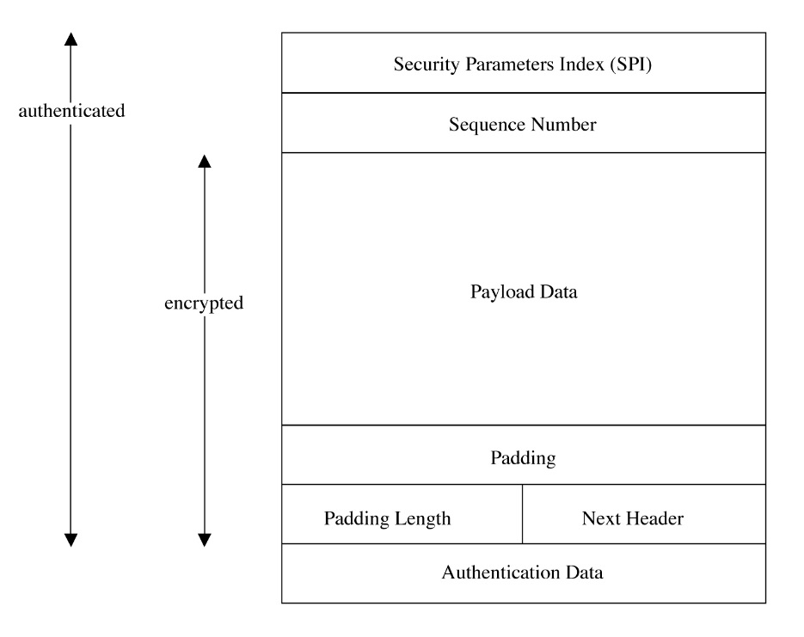
IPSec
IPSec (IP Security Protocol Suite) is a group of protocols designed to provide security for general IP communication
There is an Authentication Header (AH) mode that provides authentication and integrity by supplying a cryptographic hash of the message and its addresses
There is an Encapsulated Security Payload (ESP) mode that can provide encryption, authentication, or both
In transport mode, IPSec encrypts only the payload of the packet
In tunnel mode, IPSec encrypts the entire packet and puts it inside of another packet, hiding its final destination inside of a private network

Slide 23
Content integrity
Encryption helps protect integrity from malicious attackers
Error correcting codes (like parity checks) can help prevent non-malicious problems with integrity
Cryptographic checksums (AKA cryptographic hash digests) protect from both malicious and non-malicious threats to integrity

Slide 24
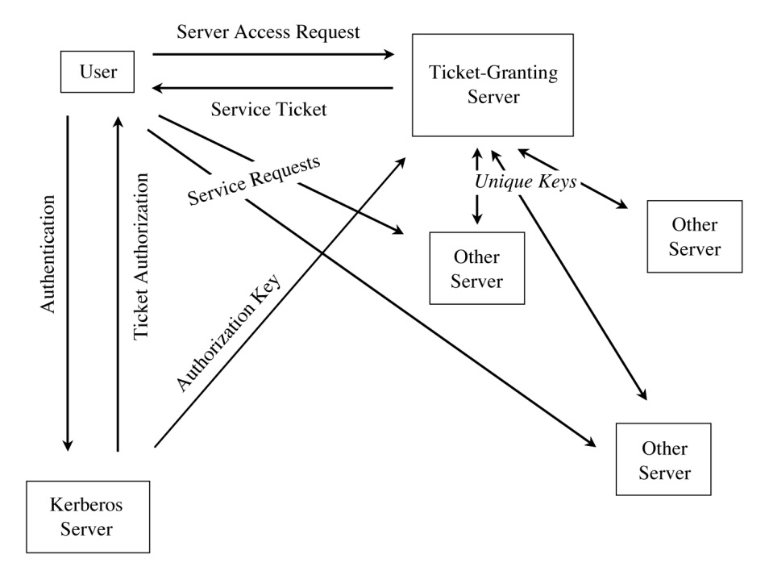
Strong authentication
Who are you talking to? Passwords can be stolen
One-time passwords prevent the problem of stolen passwords
RSA SecurIDs and other password tokens generate one-time passwords
Challenge-response systems serve a similar role
Kerberos is a system designed at MIT
Users interact with an authentication server who authenticates them
They get a ticket to access a file from a ticket granting server
The ticket lets you use a file
Everything is time-stamped

Slide 25
Access controls on routers
Routers want to block packet floods from affecting the servers behind the router
We can have ACLs that list all the legal (or all the illegal) hosts that can send (or are not allowed to send) packets into the network
But, checking packets against ACLs slows down the system, making the router easier to flood
Since it is possible to forge source addresses, the ACLs might not correctly block the packets

Slide 26
Firewalls

Slide 27
Firewalls
A firewall filters traffic between an inside network and an outside network
The inside is more trusted and needs to be protected from the outside
Kinds of firewalls:
Packet filtering gateway or screening routers
Stateful inspection firewalls
Application proxies
Guards
Personal firewalls

Slide 28
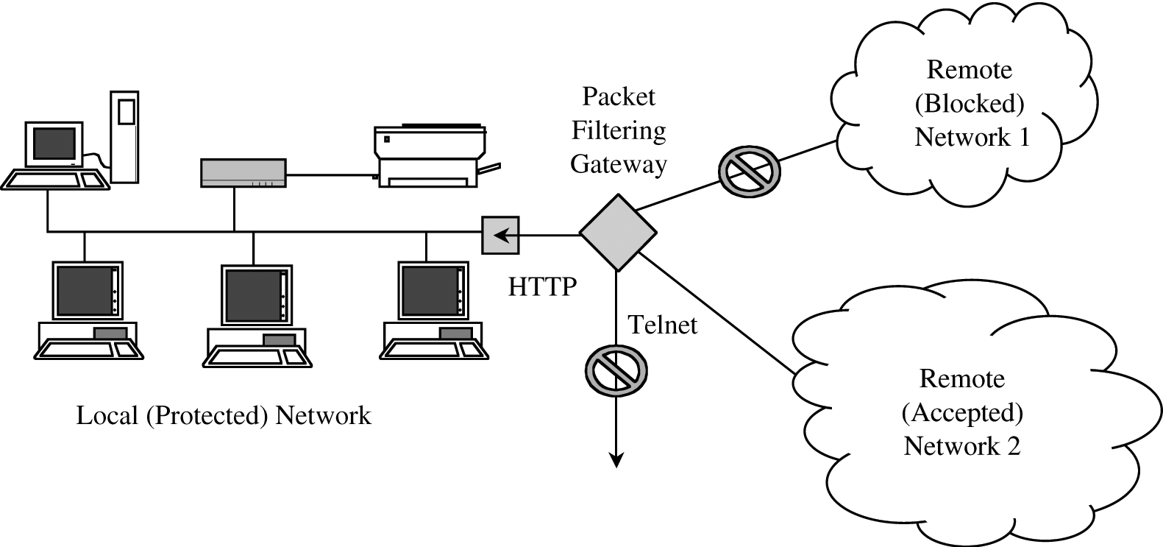
Packet filtering gateway
Packet filtering gateways are simple
They only allow certain packets to get by
Based on source or destination address
Based on protocol (HTTP on port 80, for example)
A packet filter can be used in combination with other firewalls
The packet filter can remove a lot of traffic so that a more complex firewall has to worry about checking fewer packets
Packet filters ignore the data inside the packets
They only use the addresses and port numbers

Slide 29
Stateful inspection firewall
A stateful inspection firewall keeps track of data inside of packets
For example, if a host inside the firewall initiates a TCP connection with a host outside, a stateful inspection firewall can remember this and let only that particular outside host’s packets in

Slide 30
Application proxies and guards
An application proxy gateway (or bastion host) appears to function like a host running a particular application
The outside world sends date to the application proxy’s IP address
The application proxy changes the addresses and forwards the data on to the real server
Only appropriate requests and responses are allowed through
All accesses can also be logged
A guard is really the same thing, just with more functionality
For example, a guard might reassemble a file and run it through a virus scanner

Slide 31
Personal firewalls
A personal firewall is software that runs on a workstation
These firewalls can give additional protection
The user and OS can have very fine grained control over what kind of connections can be made and what kind of applications can send and receive data

Slide 32
Network address translation
Firewalls generally do network address translation (NAT)
Outsiders direct all traffic to the firewall
The firewall keeps track of which internal host is sending traffic on a particular port
Thus, outsiders don't even know which machines or addresses exist behind the firewall

Slide 33
Upcoming

Slide 34
Next time…
Intrusion detection
Database background
Security requirements of databases
Database reliability and integrity
Aidan Kent presents

Slide 35
Reminders
Reading Sections 7.1 through 7.3
Form teams for Project 3
I need the name of the leader
You will need to create passwords and secret messages for every team in class

